Slide 1


Slide 2


Society Management
Second Year Project Synopsis
Submitted by
ROLL | NAME
Fayyaz Khan | 2301010261
Abhay Gandotra | 2301010262
Pakhi Kumari | 2301010213
Harman Jeet Singh | 2301010252
Industry Mentor:
Faculty Mentor:
Notes:
New Courses replaced with New Programmes

Slide 3

Project Overview
Managing a residential society is a complex task that involves handling communication, service coordination, complaint resolution, and security. Traditional methods lead to inefficiencies, mismanagement, and inconvenience for residents.
Our proposed Society Seva App is a centralized digital solution that streamlines society operations, enhances communication, and simplifies service access for residents.
Notes:
New Courses replaced with New Programmes

Slide 4
About the Problem
Managing a residential society involves multiple challenges, such as communication gaps, inefficient service coordination, and delayed complaint resolution. Traditional methods rely on manual processes, notice boards, and word-of-mouth communication, leading to mismanagement and inconvenience for residents.
Additionally, residents struggle with booking essential services (maids, electricians, plumbers), buying daily essentials, and raising complaints effectively. A centralized digital solution is needed to streamline these operations, enhance communication, and improve overall society management.
Notes:
New Courses replaced with New Programmes

Slide 5
Gaps between residents and society administration.
Inefficient Service Coordination for maintenance,
repairs, and household needs.
Delayed Complaint Resolution due to lack
of a structured system.
Limited Community Engagement with outdated
notice boards and scattered information.
Problem Statement
Notes:
New Courses replaced with New Programmes

Slide 6
Objectives
Develop a user-friendly digital solution for society management. Ensure better coordination between residents and the administration. Enable digital service bookings for maintenance, repairs, and household needs. Improve transparency & security with complaint tracking and digital notices. Enhance community engagement with events, announcements, and discussions.
Notes:
New Courses replaced with New Programmes

Slide 7
Methodology, Tools, and Techniques
The app will be developed using Agile Methodology with iterative development, user feedback, and continuous improvements.
Tech Stack;
Frontend: Flutter / React Native
Backend: Node.js / Django
Database: Firebase / SQL
Payment Gateway: Razorpay / Stripe
Notifications: Firebase Cloud Messaging
Notes:
New Courses replaced with New Programmes

Slide 8
Methodology Flowchart
Problem Identification
↓
Requirement Gathering
↓
System Design (App UI/UX, Database Structure)
↓
Development Phase (Frontend & Backend Implementation)
↓
Testing & Debugging
↓
Deployment & User Feedback
↓
Final Enhancements & Launch
Notes:
New Courses replaced with New Programmes

Slide 9
Project Timeline
Week 1-2: Problem Identification & Requirement Gathering – Researching key challenges, identifying objectives, and defining requirements. Week 3-4: System Design & Planning – Creating wireframes, designing UI/UX, defining the database structure, and finalizing the tech stack. Week 5-8: Development Phase – Implementing the frontend and backend, integrating APIs, and building core features.
Notes:
New Courses replaced with New Programmes

Slide 10
Project Timeline
Week 9-10: Testing & Debugging – Conducting unit testing, fixing bugs, and improving user experience.
Week 11: Deployment & Feedback – Launching the beta version, gathering user feedback, and making necessary adjustments.
Week 12: Final Enhancements & Launch –Implementing improvements and paring the final version for release.
Notes:
New Courses replaced with New Programmes

Slide 11
Expected Results & Impact
A fully functional Society Management App that enables efficient administration, digital services, and a seamless resident experience.
Impact on the Community: Reduces communication gaps with instant notifications and updates. Improves service accessibility by providing digital booking options. Streamlines complaint resolution through real-time tracking. Enhances community engagement with digital notices and event updates. Promotes a smart & connected society with an integrated digital ecosystem.
Notes:
New Courses replaced with New Programmes

Slide 12
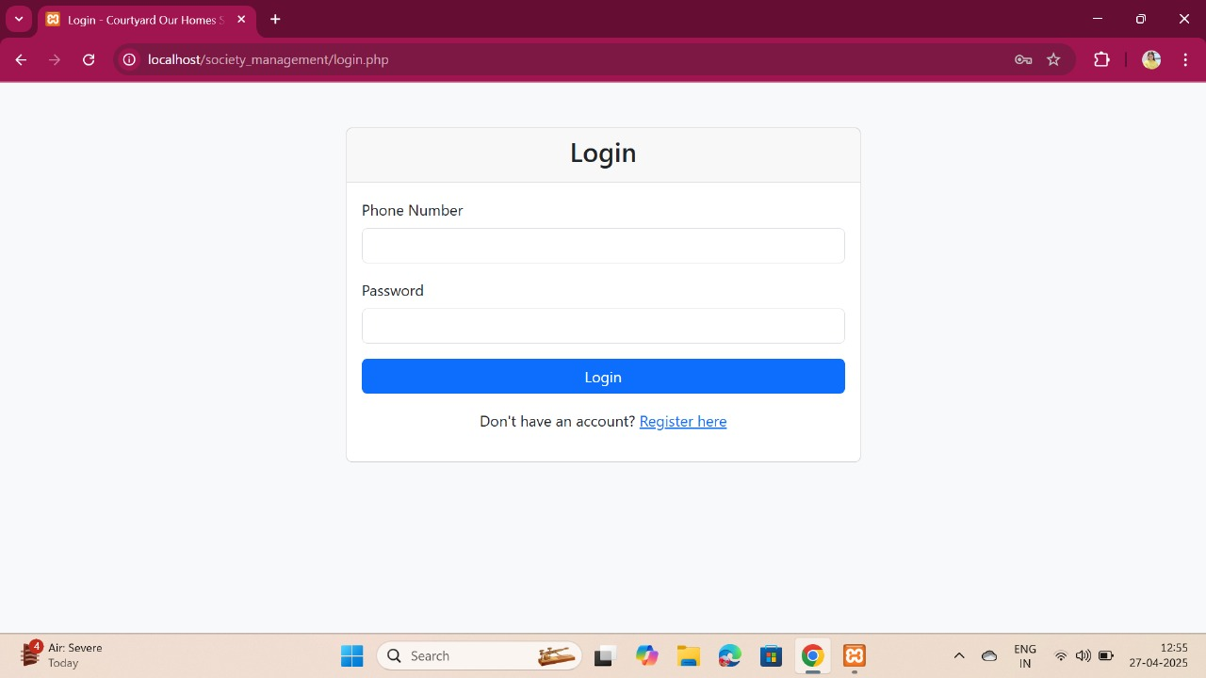
Real-Time Experience
Login Page
Notes:
New Courses replaced with New Programmes

Slide 13
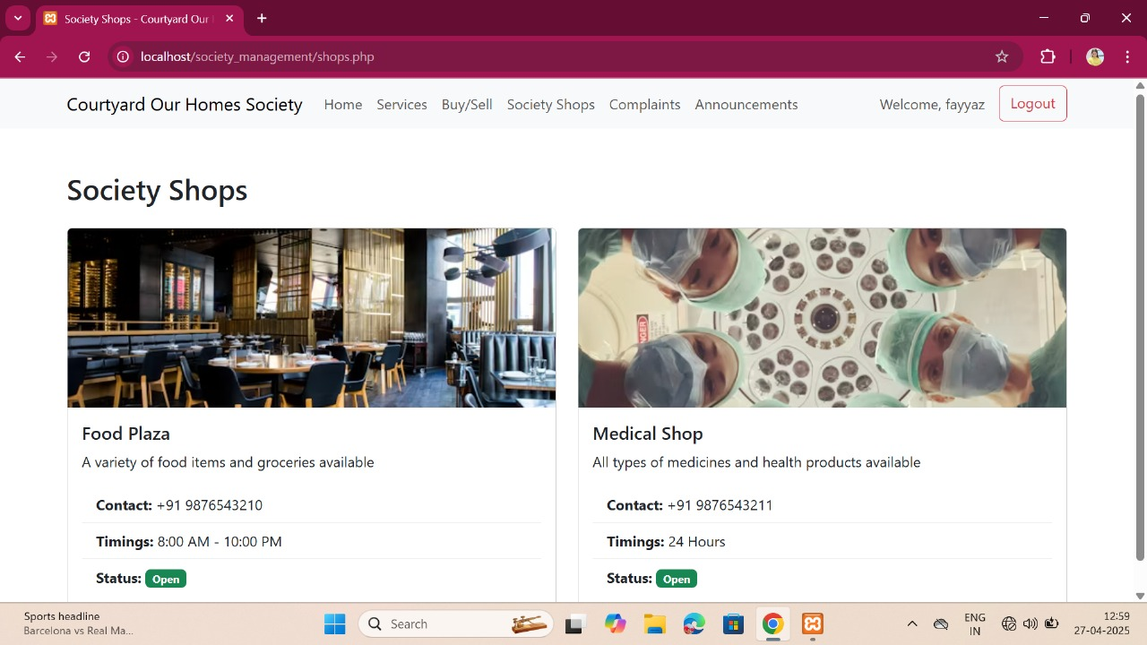
Real-Time Experience
Notes:
New Courses replaced with New Programmes

Slide 14
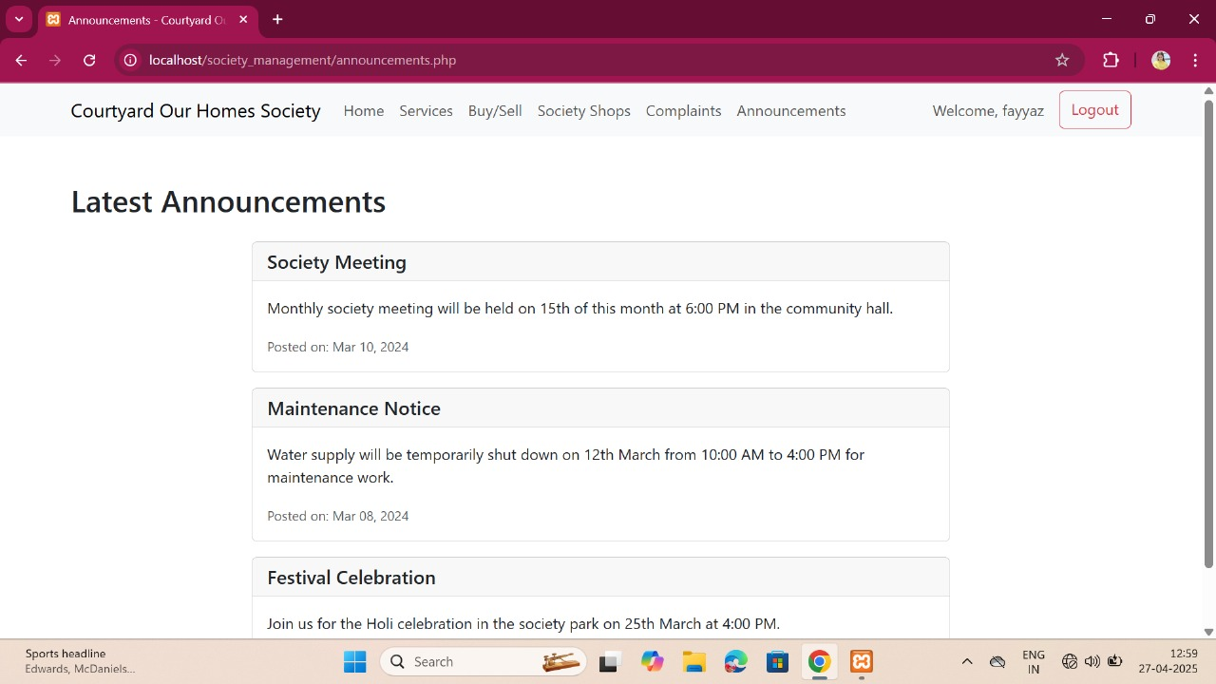
Real-Time Experience
Notes:
New Courses replaced with New Programmes

Slide 15
Real-Time Experience
Notes:
New Courses replaced with New Programmes

Slide 16
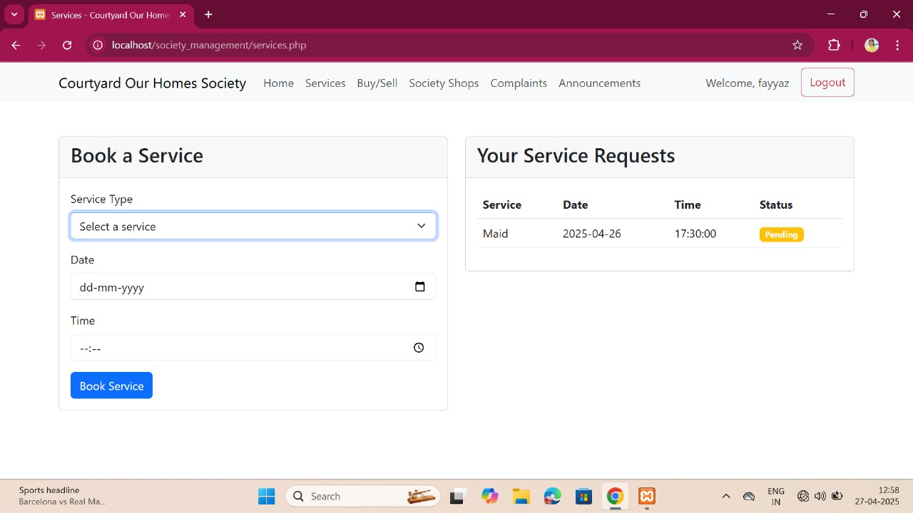
Real-Time Experience
Notes:
New Courses replaced with New Programmes

Slide 17
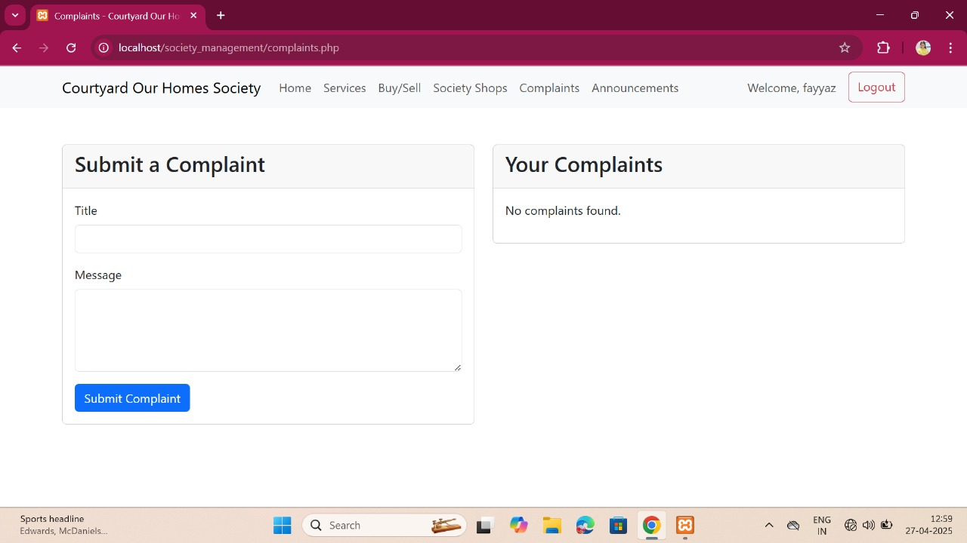
Real-Time Experience
Notes:
New Courses replaced with New Programmes

Slide 18
References
Brown, T. (2020). Smart Community Management: Digital Solutions for Residential Societies. Springer.
Smith, J., & Patel, R. (2019). Enhancing Residential Living with IoT and Mobile Applications. Journal of Smart City Technologies, 12(3), 45-60.
Google Developers. (n.d.). Flutter Documentation. Retrieved from https://flutter.dev/docs
Mozilla Developer Network (MDN). (n.d.). Node.js and Backend Development. Retrieved from https://developer.mozilla.org/
Firebase. (n.d.). Firebase Cloud Messaging for Real-time Updates. Retrieved from https://firebase.google.com/docs
Stripe. (n.d.). Online Payment Integration Guide. Retrieved from https://stripe.com/docs
Agile Alliance. (2015). Understanding Agile Development Methodologies. Retrieved from https://www.agilealliance.org/
Notes:
New Courses replaced with New Programmes

Slide 19
THANK YOU

